Slide 1
Welcome Home Celebration Alumni UK Japan Spotlight: Application guidelines and template

Slide 2
Alumni UK Japan Spotlight
🎓 Alumni UK Japan Spotlight について
Alumni UK Japan Spotlight は、英国の大学・大学院留学を経験した皆さまの留学後のストーリー、成果、 そして多様な経験を紹介するクリエイティブなショーケースです。
ご自身の歩みや英国での学びが、どのように現在の仕事や人生に影響を与えているのか、ぜひお聞かせください。
あなたらしさを表現できるよう、スライドのデザインや構成は自由にアレンジしていただいて構いません！ ただし、スライドは英語で作成し、必ず以下の内容を含めてください：
1️⃣ 氏名 2️⃣ 大学名および専攻・プログラム名（在籍年） 3️⃣ 5つのテーマのうち1つへの簡単な回答 4️⃣ ご自身の写真
📋 作成時の注意
ヘッダーと#ハッシュタグ は消去せずそのまま残してください。
完成したスライドのファイルは、次の規則に従い命名してください。 📁20251214_welcome-home_alumni-spotlight_名-姓 （例：20251214_welcome-home_alumni-spotlight_jyuri-michino）
作成したスライドは、2025年11月30日（日）23:59（日本時間）までに、 < alumni@britishcouncil.or.jp > 宛てにメール添付で提出ください。
📎 作成にあたり、5枚目のスライド「Sample + Guidelines Slide」を参考にしてください。
💬5つのテーマ (いずれか１つの選択)
今でも自分に影響を与えている英国留学での学び
英国留学経験が仕事や地域での活動に与えた影響
現在関わっているプロジェクトや取り組みの紹介
英国の文化・教育・コミュニティで印象に残っていること
Alumni UK Japanコミュニティの未来への希望や目標

Slide 3
Alumni UK Japan Spotlight
🎓 About the Alumni UK Japan Spotlight
The Alumni UK Japan Spotlight is a creative showcase celebrating the stories, achievements, and diverse experiences of international UK Alumni. Each spotlight highlights your personal journey — what you learned through your UK experience and how it continues to shape your work and life today.
You’re warmly encouraged to make your slide your own! Feel free to be creative with visuals, design, and layout — just be sure to create the slide in English and include: 1️⃣ Your name 2️⃣ University name and programme (year/s) 3️⃣ A short response to one of the five prompts (see below) 4️⃣ A photo of yourself 💬 Prompts (choose one)
What did you learn from studying in the UK that continues to influence you today?
How has your UK experience shaped the way you approach your work or community involvement?
What is one project or initiative you’re currently involved in that you’re proud to share?
What aspect of UK culture, education, or community left a lasting impression on you?
What is one hope or aspiration you have for the Alumni UK Japan community moving forward?
Please keep the header and #hashtag visible, and save your completed slide using the following file naming convention: 📁 20251214_welcome-home_alumni-spotlight_firstname-lastname (Example: 20251214_welcome-home_alumni-spotlight_jyuri-michino)
Submit your slide as an email attachment, to < alumni@britishcouncil.or.jp > before 23:59 JST on Sunday 30 November 2025.
📎 Refer to the “Sample + Guideline” (Slide 6 below) for reference before creating your own slide.

Slide 4
TEMPLATE
*Delete this shape in your final version!
Alumni UK Japan Spotlight
[Firstname SURNAME]
[UK University name] – [Course] [(20XX-20XX <years you studied)]
[Your current organisation name], [Your current role]
[Your response to one of the prompts 1-5]
[Short biography]

Slide 5
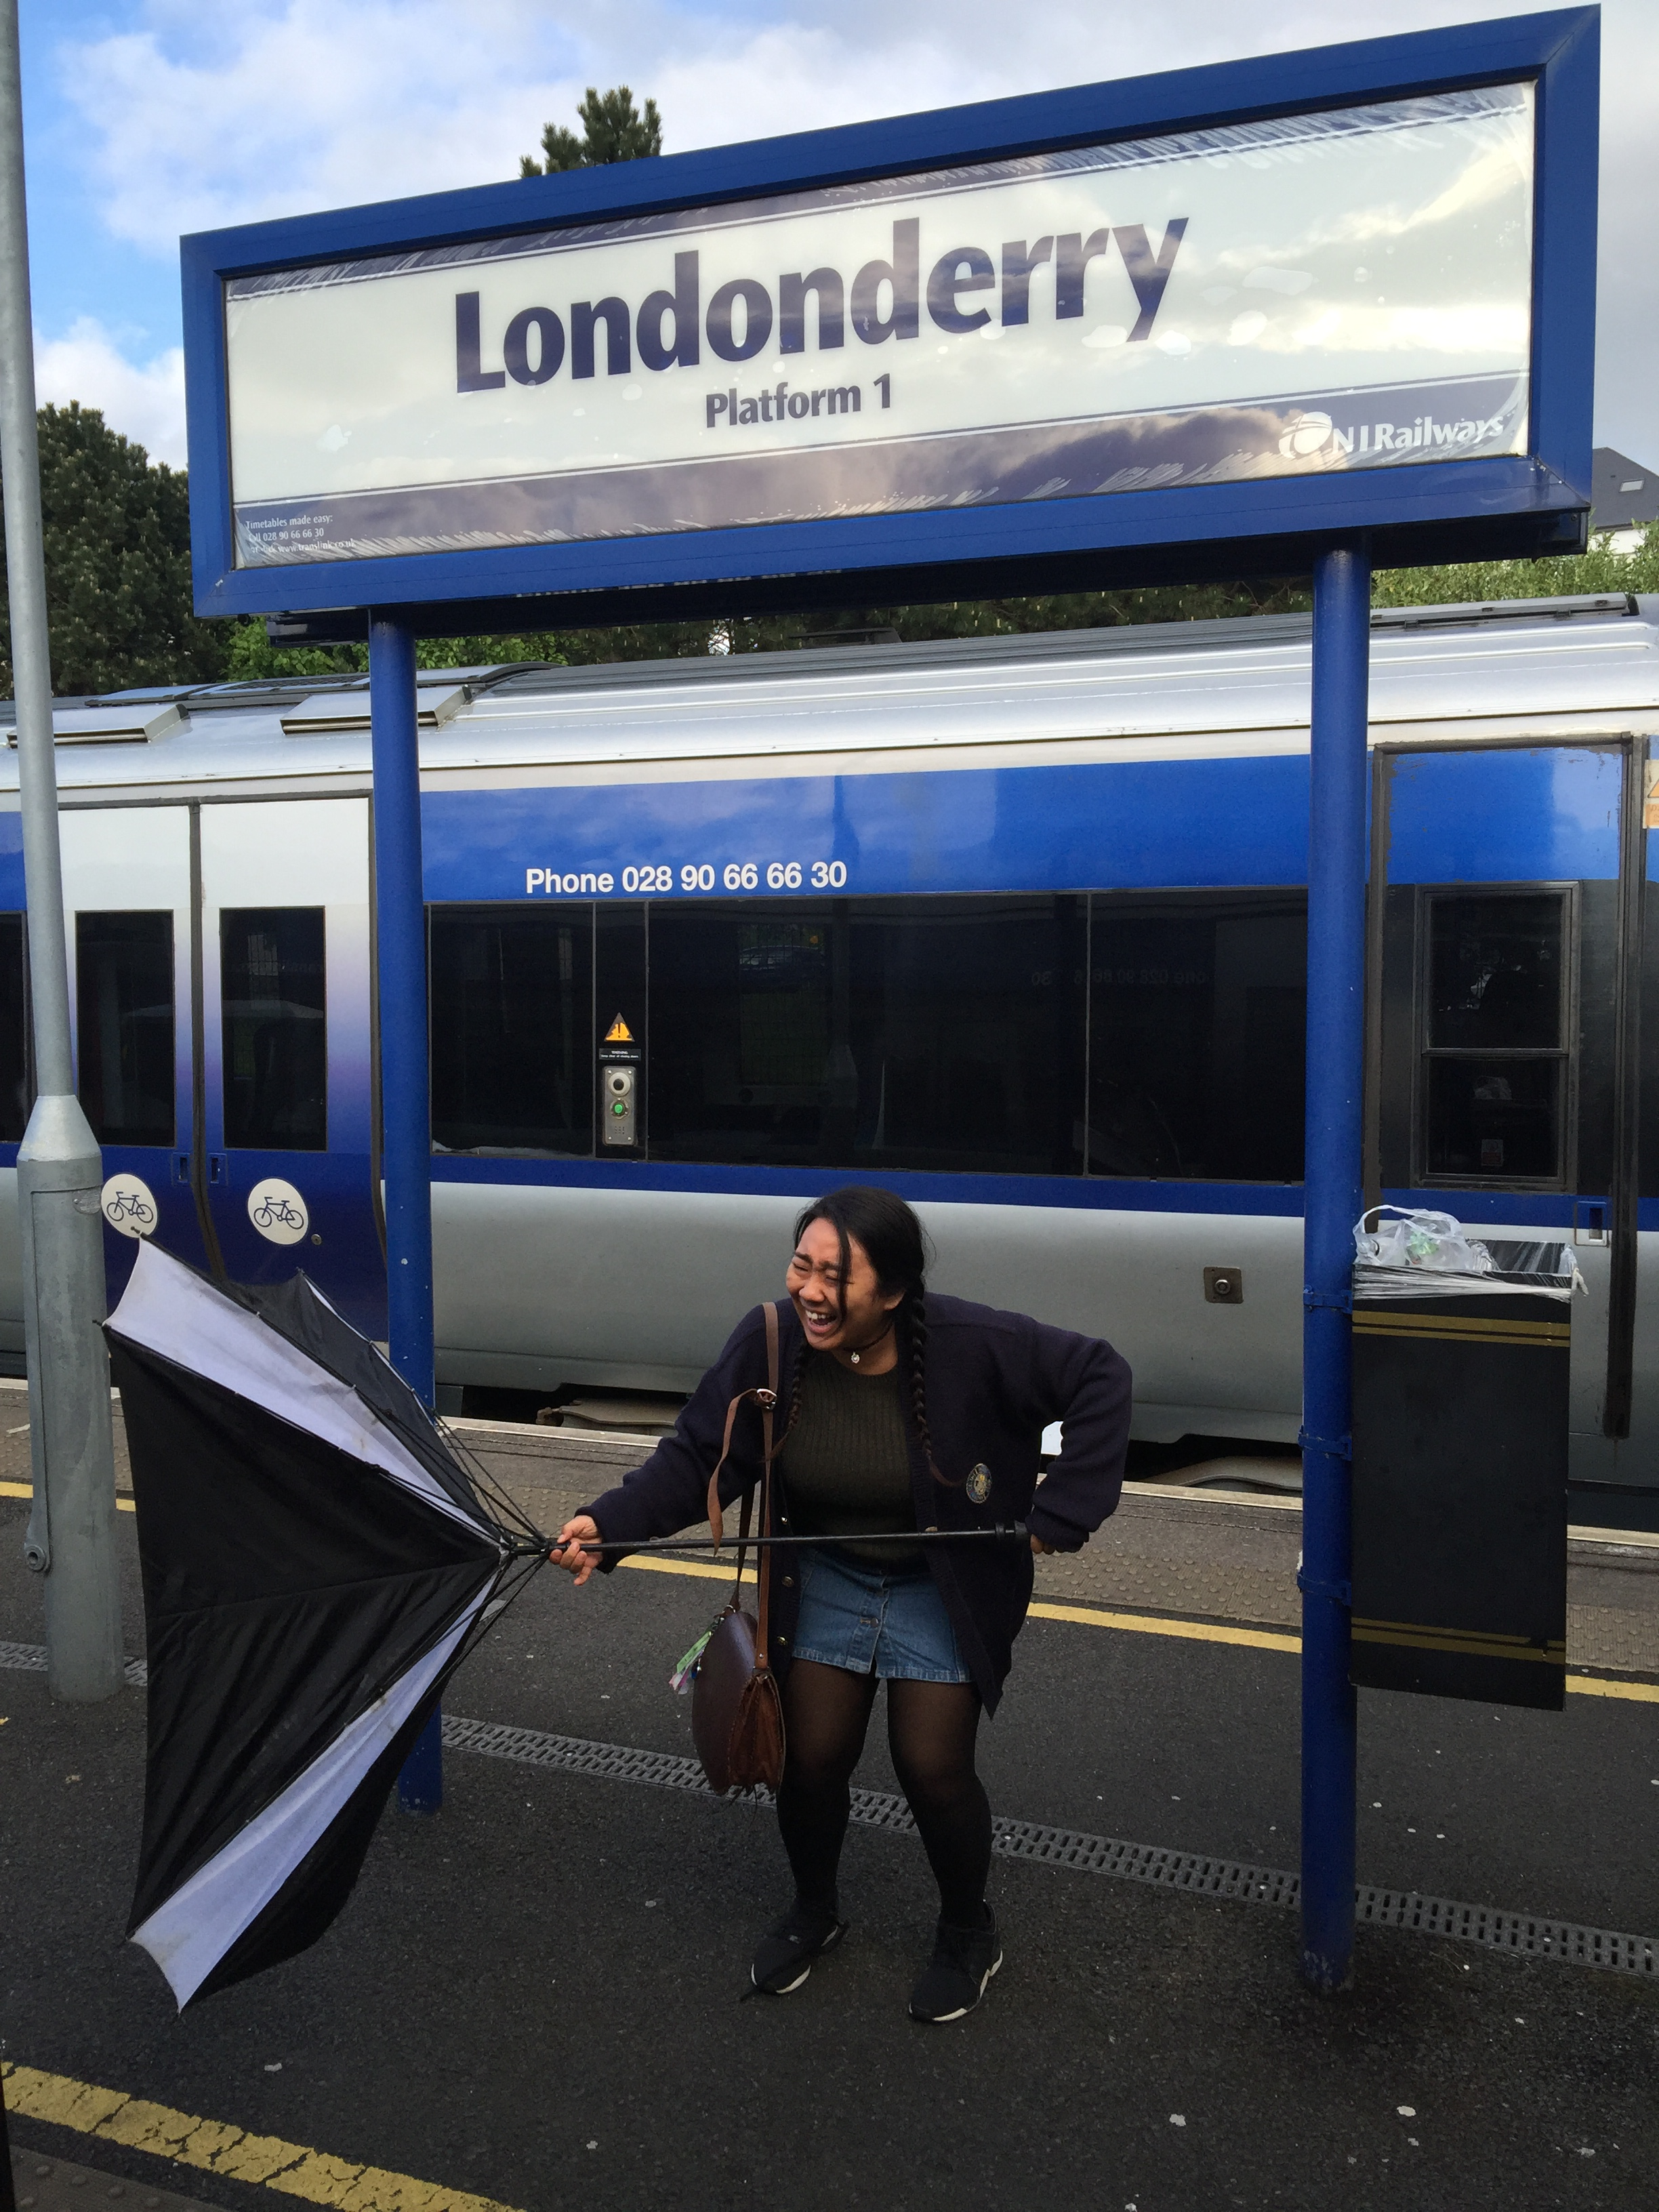
Sample + Guidelines Slide
Alumni UK Japan Spotlight
名前のテキストの推奨最小サイズ：54pt
ヘッダー部分に他のテキストや画像を重ねないでください
写真は自分だけが写っているものをお使いください
サイズの調整は自由です
Jyuri MICHINO
Queens University Belfast BA International Politics and Conflict Studies (2015-2016)
British Council Japan, Programme Manager Education
“Studying in Northern Ireland taught me while conflict leaves deep marks on communities, it also nurtures a shared understanding among people, a collective determination that peace must always prevail.”
Jyuri has worked extensively in peacebuilding through education in her professional career
テキストの推奨 最小サイズ：18pt
#ハッシュタグ テキストに他の テキストや画像を重ねないでください

Slide 6
Sample + Guidelines Slide
Alumni UK Japan Spotlight
Recommended minimum text size for name: 54pt
Keep header visible and clear of any other text or objects
Make sure you are alone in the photo! Feel free to resize
Jyuri MICHINO
Queens University Belfast BA International Politics and Conflict Studies (2015-2016)
British Council Japan, Programme Manager Education
“Studying in Northern Ireland taught me while conflict leaves deep marks on communities, it also nurtures a shared understanding among people, a collective determination that peace must always prevail.”
Jyuri has worked extensively in peacebuilding through education in her professional career
Recommended minimum text size: 18pt
Keep #Hashtag visible and clear of any other text or objects

